Slide 1
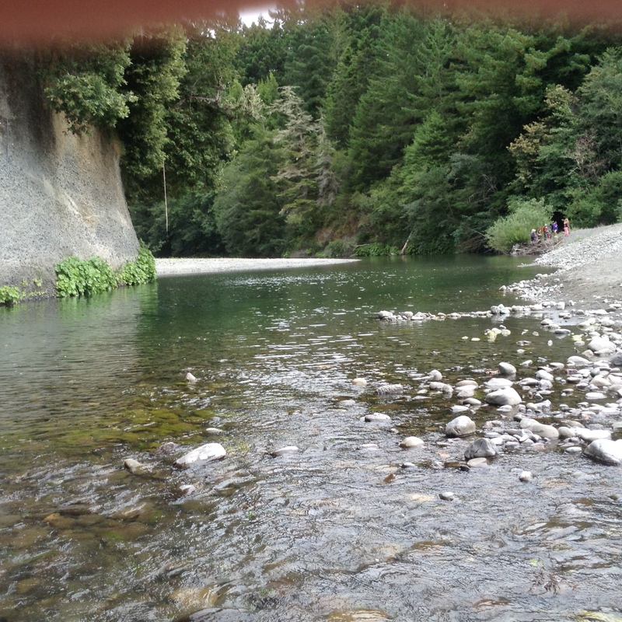
Living in the Van Duzen Watershed

Slide 2
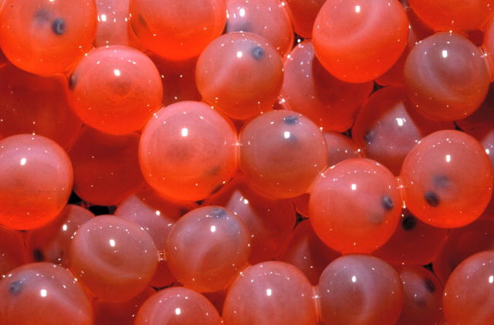
Imaging that you are a salmon egg.

Slide 3
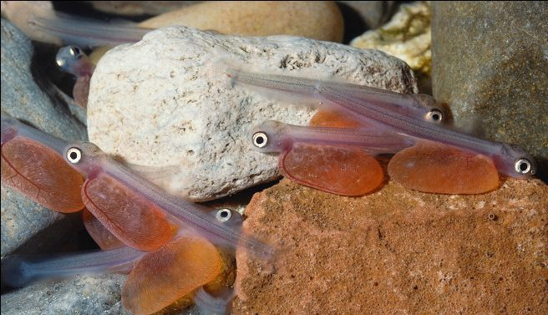
You come out of your egg carrying you own food supply. This is called the alevin stage.

Slide 4
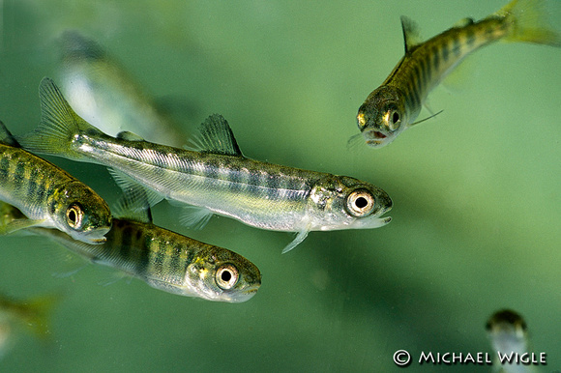
You use that up and now you have to find your own food. You are called a fry.

Slide 5
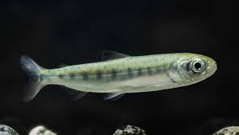
Look at your parr marks. Why do you have them?

Slide 6
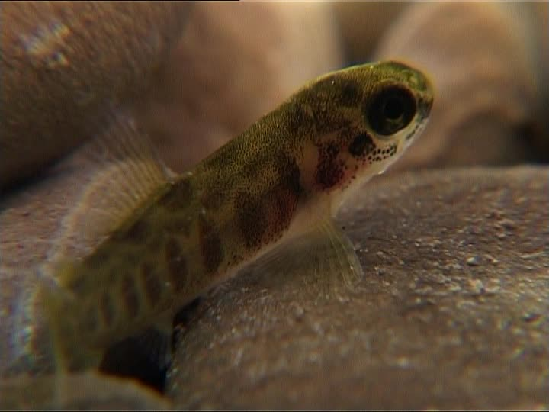
Heading Downstream
What dangers would you face?

Slide 7
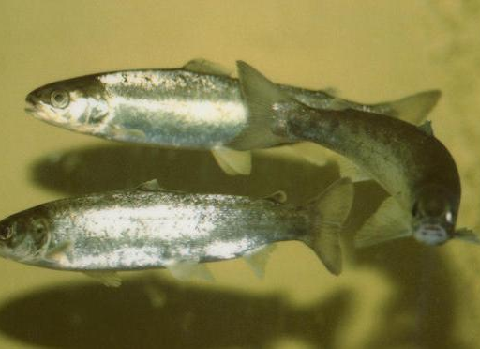
From Freshwater to Salt Water.
You head downstream past many obstacles avoiding being eaten.
You find places to hide.
You like the freshwater cool around 60-65 degrees.
You make it to the estuary.
This is the place with both freshwater and salt water as your body begins to change.
Then you are ready for the ocean.

Slide 8
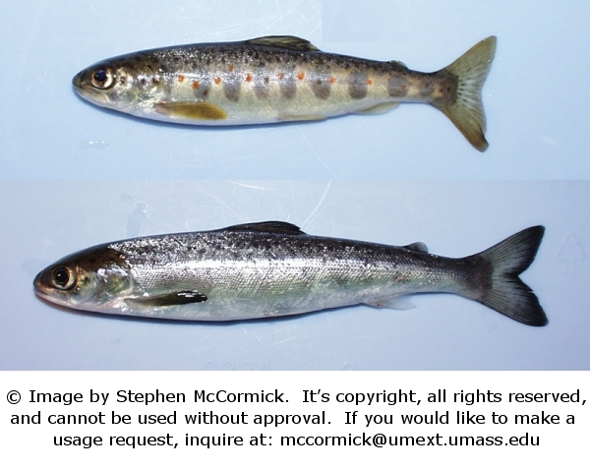
Fry to Smolt
As all organisms change the salmon has now undergone a huge change to go from a fry into a smolt ready to head to the ocean.

